Slide 1

STUDENT PLACEMENT DATASET

Slide 2

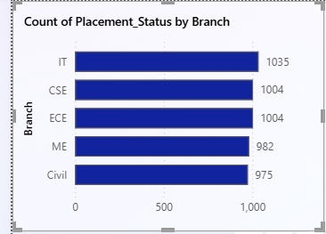
STACKED BAR CHART
This chart compares the placement Status across different branches
It is observed that some branches have a higher number of placed students, indicating better placement performance. Other branches show a higher number of not placed students, highlighting areas where placement support can be improved
This visualization helps identify branch-wise placement success.

Slide 3

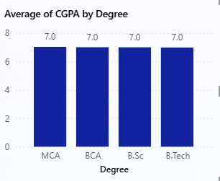
STACKED COLUMN CHART
This chart shows the average CGPA of students for each degree
The results indicate that average CGPA of B.Tech,BCA and MCA,B.sc students
This helps in understanding academic performance trends across different programs.

Slide 4

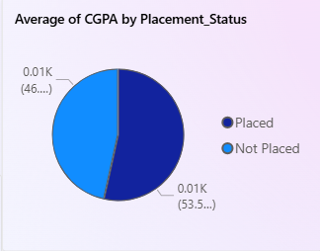
PIE CHART
The pie chart represents the percentage distribution of students based on placement status
A larger portion of students are placed
A Small portion of students are not placed
This shows the overall placement process and the general success rate of student placements.

Slide 5

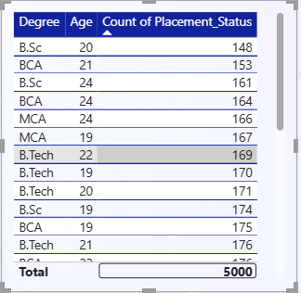
TABLE
This table shows how placement status varies by Age across different degrees
Age acts as a key branching factor that divides candidates into different groups
It helps in analyzing Age-wise placement trends.

Slide 6

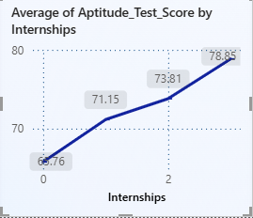
LINE CHART
This chart illustrates the relationship between the number of internships and the average aptitude test score.
It is observed that as the number of internships increases, the average aptitude score also increases.

Slide 7

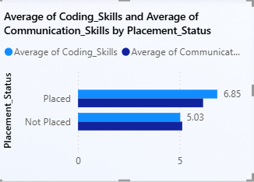
CLUSTERED BAR CHART
This chart compares average coding skills and communication skills for placed and not placed students
Placed students show higher average scores in both coding and communication skills
This indicates that strong technical and communication skills play an important role in getting placed.

Slide 8

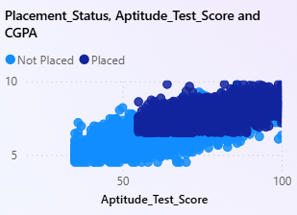
SCATTER PLOT
This scatter plot shows the relationship between CGPA and aptitude test scores
The data shows a positive correlation, where students with higher CGPA tend to have higher aptitude scores
Most placed students are concentrated in the higher CGPA and higher aptitude score range, showing that both factors strongly influence placement.

Slide 9

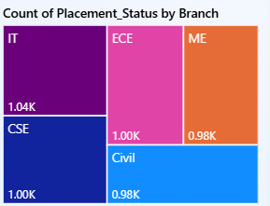
TREE MAP
The tree map highlights the branches based on the number of placed students
The branch with the largest area represents the highest number of placed students
This helps in quickly identifying the top-performing branch in terms of placements.

Slide 10

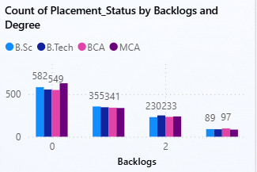
CLUSTERED COLUMN CHART
This chart shows the impact of backlogs on placement outcomes across different degrees
Students with fewer or no backlogs have a higher placement rate.
As the number of backlogs increases, the placement chances decrease.

Slide 11

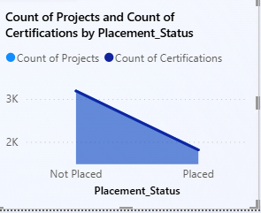
AREA CHART
This chart shows how certifications and projects together influence placement status
Students with a higher number of certifications and projects tend to have better placement outcomes.

Slide 12

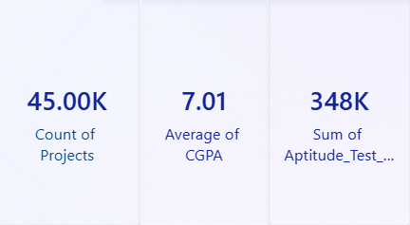
CARDS
This card displays the total number of projects completed by students. It represents the overall practical exposure of students
This card shows the overall average CGPA of all students. It provides a quick summary of the general academic performance of the student group.
This card displays the Sum aptitude test status count.

Slide 13


